Slide 1
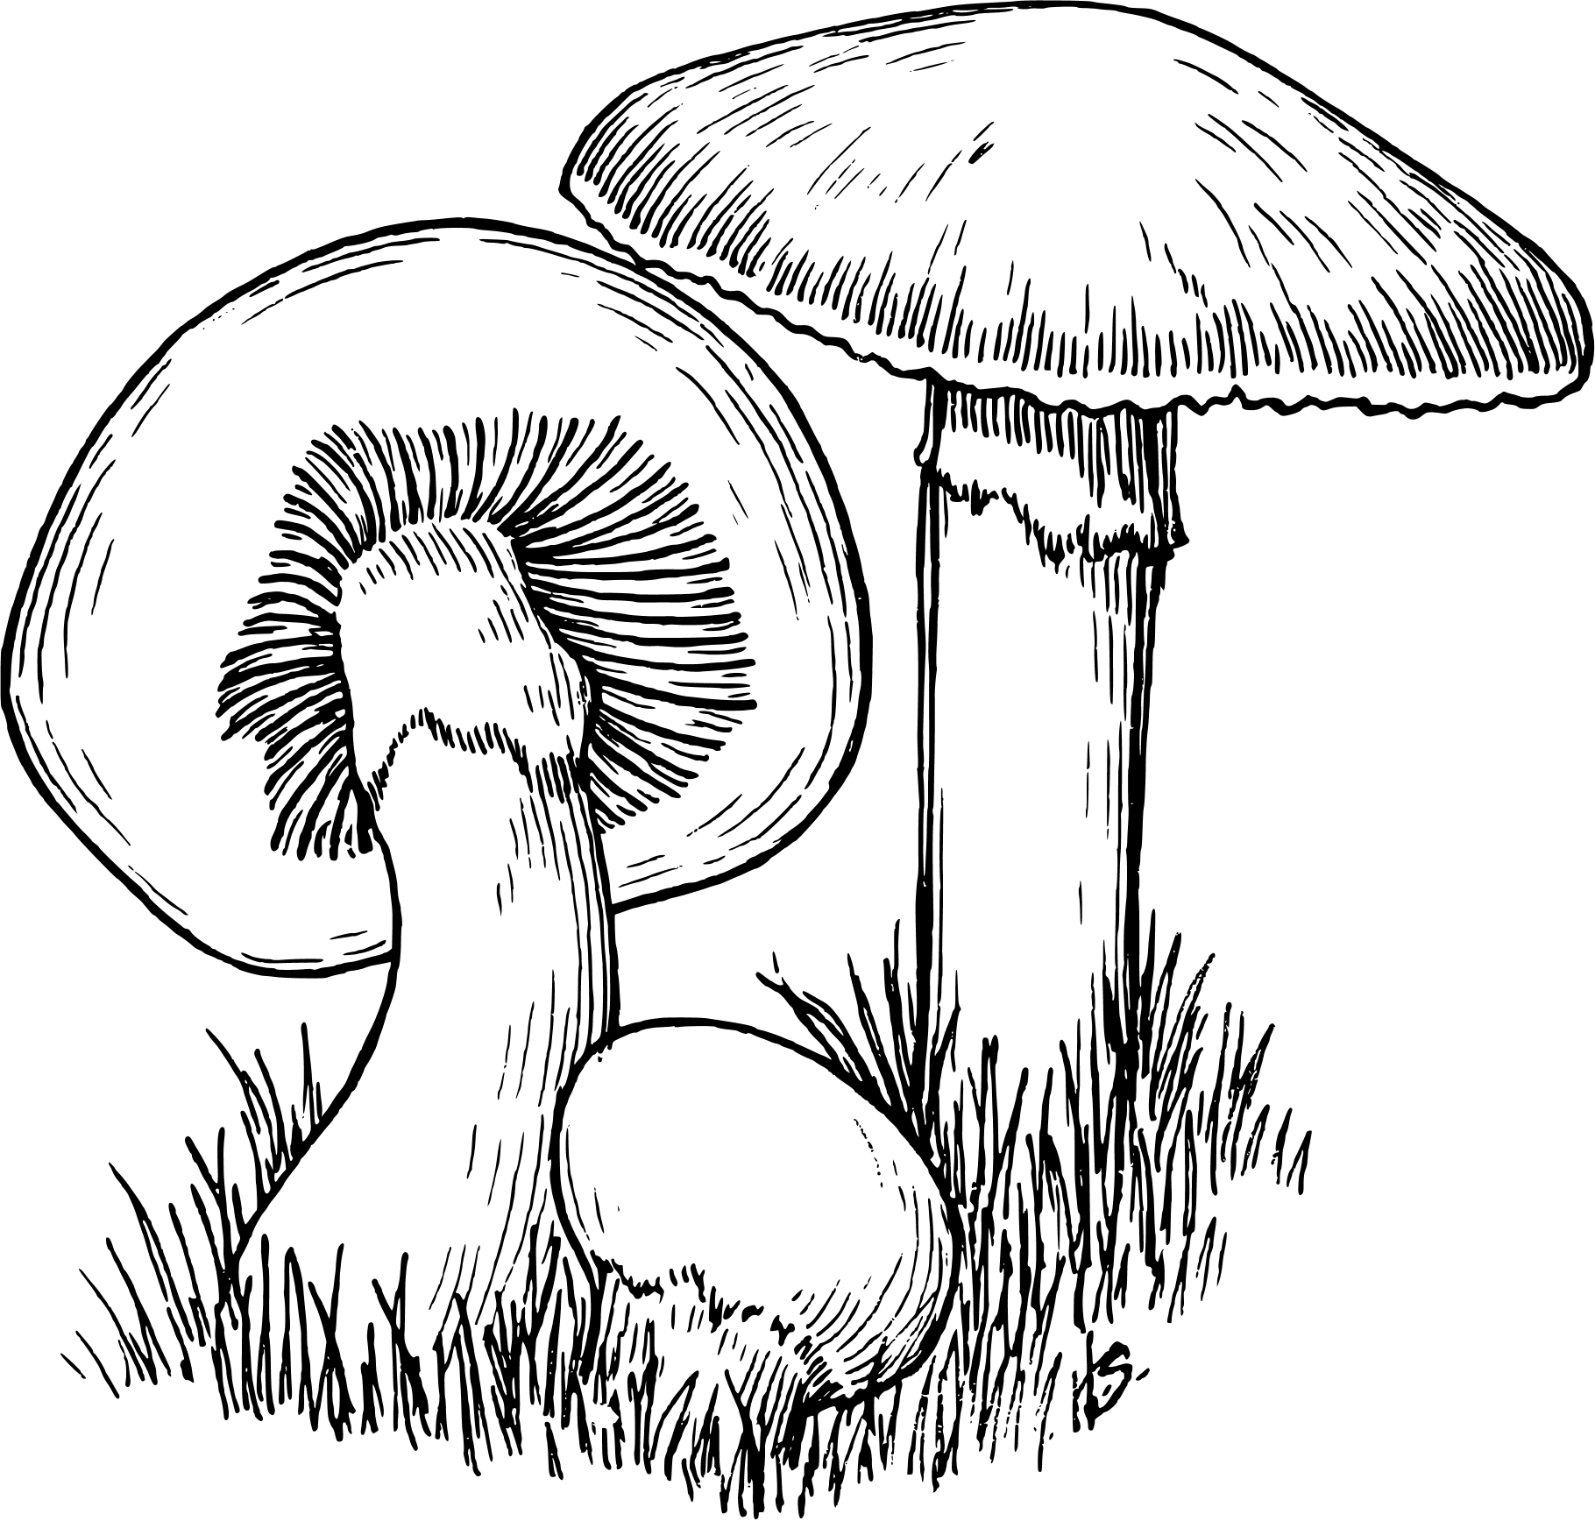

Learnbay Project Presentation
Edi-Fungi:
Safeguard foragers by distinguishing poisonous from edible mushroom
PRESENTED BY:
Theveetha T R

Slide 2

Introduction
Objective
Analysis Method
Agenda
Data Gathering
Data Description
Data Understanding
Exploratory Data Analysis
Data Preprocessing
Data Modeling
Model Evaluation
Conclusion

Slide 3
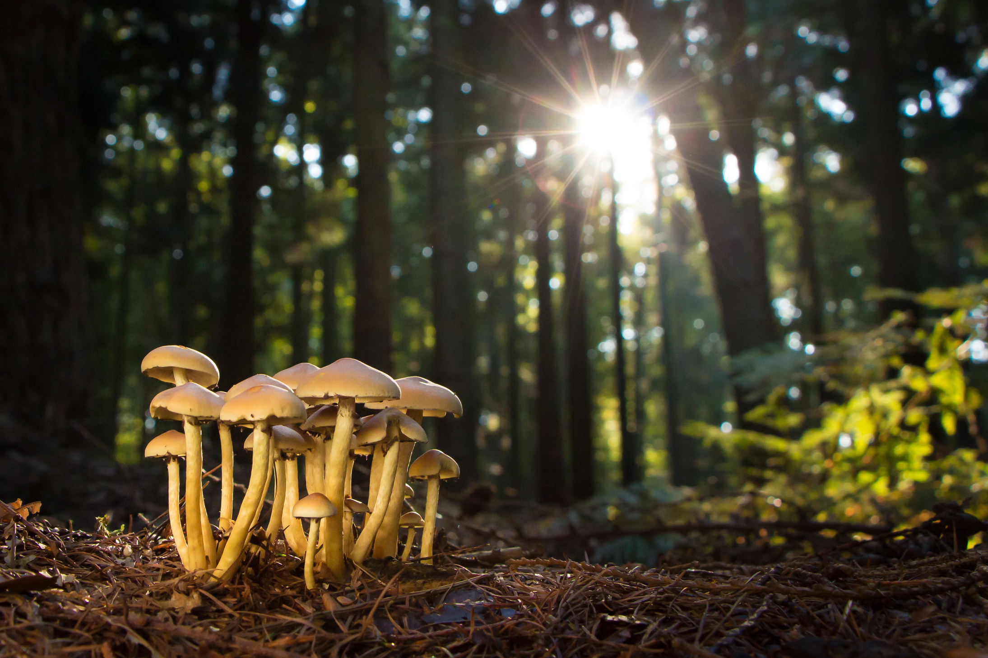
Introduction
Mushrooms : Diverse group of fungi used in cuisines.
Challenge we pose : Difficulty in distinguishing between edible and poisonous mushrooms.
Need : This classification or identification plays a crucial role in ensuring food safety and preventing the consumption of toxic or poisonous varieties

Slide 4

Objectives
Fundamental Goal
Create a model to classify mushrooms (edible or harmful) based on their attributes using Machine Learning
Purpose
To prevent accidental intake of poisonous mushrooms and promoting safe intake of edible ones
Usage
Helps mushroom foragers to make an informed decision during mushroom foraging, ultimately ensuring safety and well being of consumers
EDIBLE
OR POISONOUS

Slide 5


Analysis Method
Data Gathering
Given that the mushroom in the dataset is either classified as edible or poisonous this is a classification problem
Data Understanding
Exploratory Data Analysis
Data Preprocessing
Data Modeling
Model Evaluation

Slide 6

Data Gathering
Source of data: Dataset was provided as part of the project work
The dataset provided consists of comprehensive information on labelled mushroom samples, including information on their edibility and relevant characteristics.
The dataset covers a diverse range of mushroom species, including both edible and non edible varieties.

Slide 7
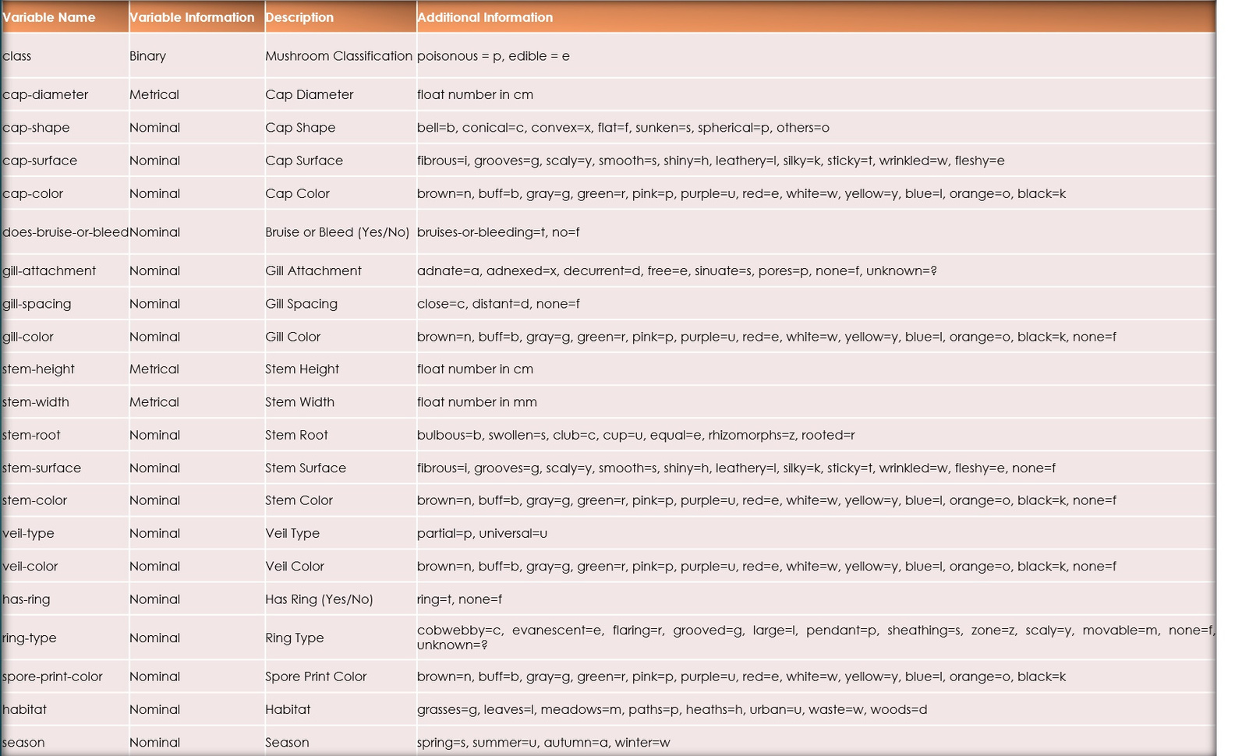
Data Description
No of Rows: 61,609
No of Columns: 21
Categorical Columns: 18
Numeric Columns: 3

Slide 8
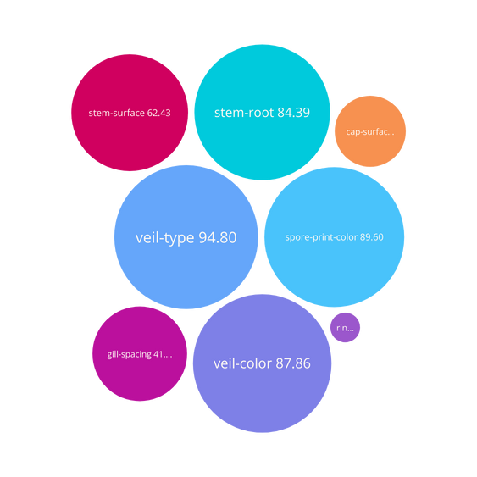
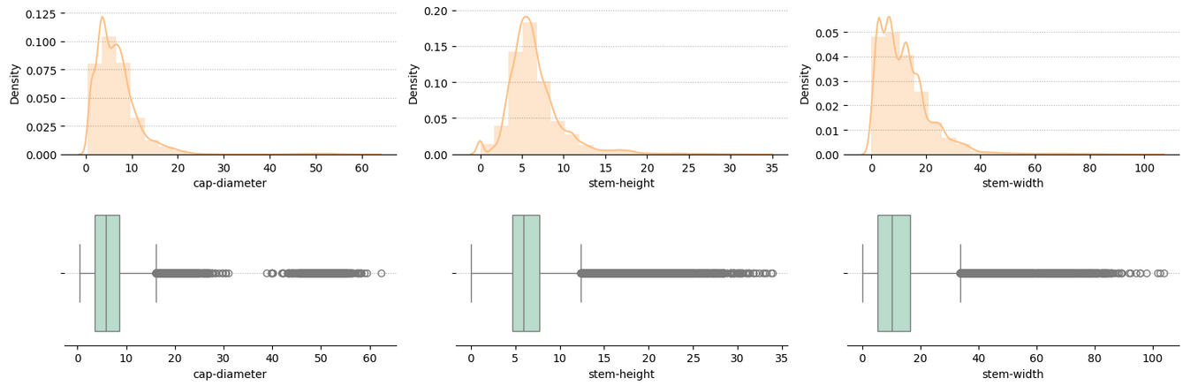
Data Understanding
Variables with missing values : 9
Variables having >60% of missing values : 5
No of duplicate records : 146
All the numerical variables are highly skewed - presence of outliers detected

Slide 9

Exploratory Data Analysis
Clean and Transform Data
Univariate Analysis
Bi-variate Analysis

Slide 10


Clean and Transform Data
Handling missing Data:
> 40% - delete the variable
<= 40% - replace with mode
Outliers percentage < 7% – no significant impact on analysis or business decision making.
Treat outliers via Capping
Post Clean and Transform Data
No of Rows: 60,923
No of Columns: 15

Slide 11
Univariate Analysis
Variable Name | Most common category | Percentage
ring-type | f - none | 83.2
does-bruise-or-bleed | f - false | 82.62
has-ring | f - false | 75.1
habitat | d - woods | 72.33
class | p - poisonous | 55.38
season | a - autumn | 49.47
cap-shape | x - convex | 44.21
cap-color | n - brown | 39.73
stem-color | w - white | 37.63
gill-attachment | a - adnate | 37.02
cap-surface | t - sticky | 36.61
gill-color | w - white | 30.35
Single category accounts for > 50% of the data, indicating a significant class imbalance within these features.
ring-type - none (f) - 83.2
bruise-or-bleed - false (f) - 82.62
has-ring - false (f) - 75.1
habitat - woods (d) - 72.33

Slide 12
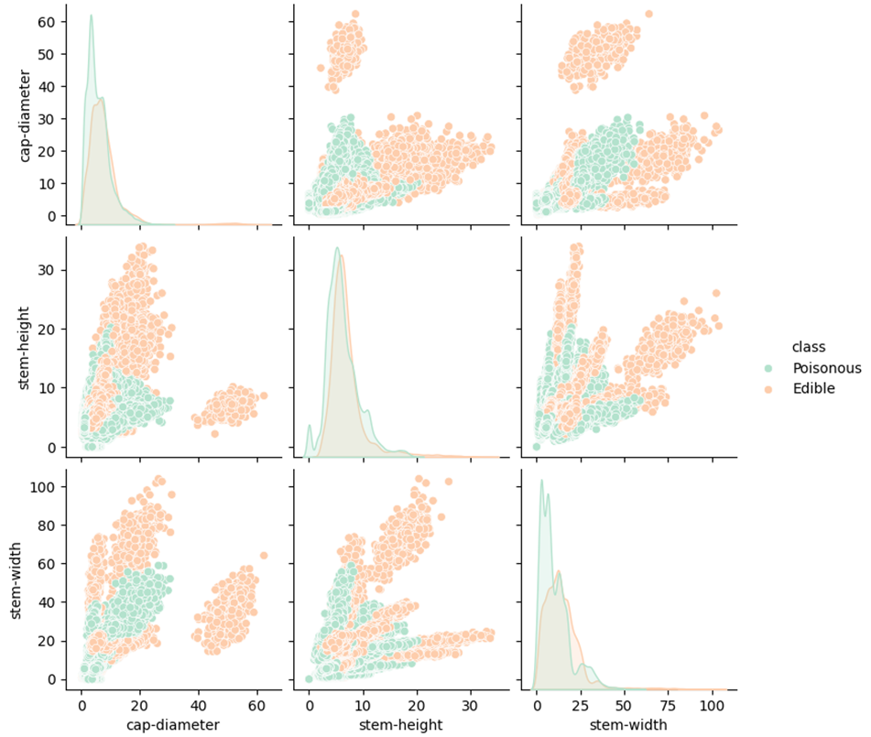
Bi-variate Analysis
Numeric variables
Numeric variables strong correlation between them
Large mushrooms - cap-diameter, stem-height and width - good indicator for edible mushroom
Medium-sized mushrooms - equal distribution of edibles and poisoners
Minimum stem height, width, and cap diameter - poisonous category

Slide 13
Bi-variate Analysis
Categorical variables
Habitat and Season
Cap specifications
Other Specifications
Poisonous:
Without rings/ zoned rings
Woods and Paths
Autumn season
Edible:
Movable ring type
100% - Urban and Waste habitat
Spring and Winter
Poisonous:
Bell shaped cap
Silky or Fibrous cap
Green cap colored
Edible:
Spherical shaped cap
Shiny, scaly, or smooth cap
Brown, gray, and buff
Poisonous:
Adnate gill attachment
Yellow and Brown (gill/ stem color)
Edible:
Free or Pores gill attachment
White, Buff and Grey (gill/ stem color)

Slide 14
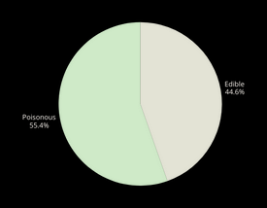
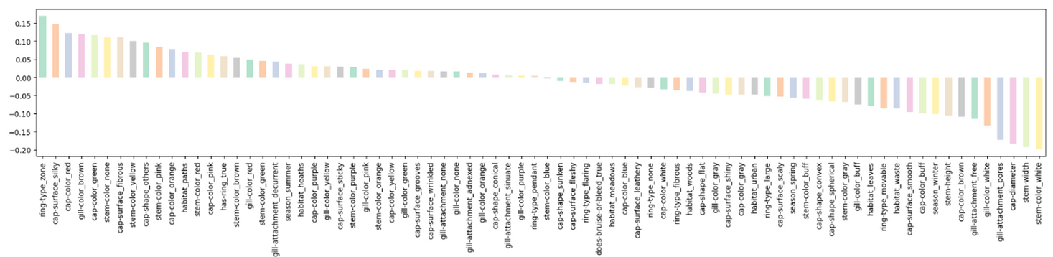
Data Pre-processing
Imbalance Data
One hot Encoding
Feature Selection
Balanced Distribution – no need of SMOTE
Convert categorical variable to numerical variable via one hot encoding
Threshold-based feature selection – evaluate correlation matrix and eliminate less significant variables
Edible: 44.62%
Poisonous: 55.4%
Purpose - enhance model efficiency and performance.
No of rows: 60,923; No of columns: 38
Problem statement - increased column count (78)
Target Variable

Slide 15
Data Modelling
Train-Test split : 80%-20%
Comparison of predicted metrices for chosen algorithms
The chosen algorithms:
Decision Tree
Random Forest
K Nearest Neighbour
Naïve Bayes
Logistic Regression
Support Vector Machine
XGBoost
method | accuracy | precision | recall | f1 | roc_auc
Decision Tree | 91.24 | 91.41 | 93.09 | 92.24 | 90.98
Random Forest | 98.84 | 98.6 | 99.34 | 98.97 | 98.78
K-Nearest Neighbour | 98.76 | 98.64 | 99.15 | 98.9 | 98.71
Naive Bayes | 67.78 | 82.77 | 53.59 | 65.06 | 69.7
Logistic Regression | 74.72 | 77.91 | 76.54 | 77.22 | 74.48
Support Vector Machine | 72.54 | 77.25 | 72.2 | 74.64 | 72.59
XG Boost | 98.17 | 97.87 | 98.89 | 98.37 | 98.07

Slide 16
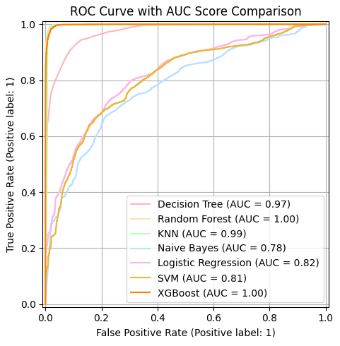
Model Evaluation
Primary evaluation metric - Precision
Reason - we can prioritize minimizing the risk of misclassifying poisonous mushrooms (crucial safety concern).
Precision = True Positive / (True Positive + False Positive)
Random Forest – Eliminated
Overfitted as ROC curve with AUC Score = 1 though it is best fit in Precision metric

Slide 17
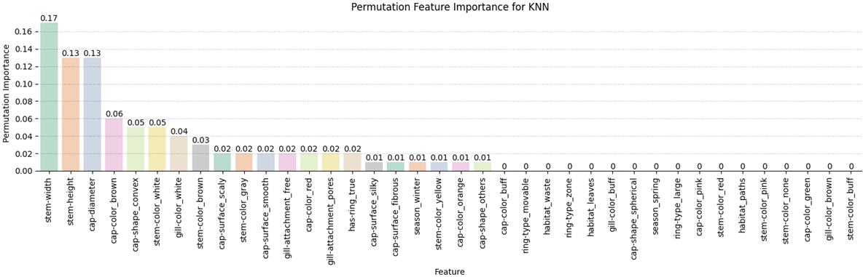
Conclusion
Inference based on primary metric precision and AUC score - K Nearest Neighbour (KNN) algorithm achieved highest precision score.
KNN is the most effective model for this task, offering the best balance of accuracy and safety in classifying mushrooms.
Features contributing for KNN model classification
Stem-width
Stem-height
Cap-diameter

Slide 18
Thank You

